Slide 1
Street Art
from “Street Art: Transfiguration of the Commonplaces”
by Nicholas Alden Riggle

Slide 2
Out of Pop Art
Art could no longer be distinguished from nonart by its visual properties
The every day objects can be transfigured by placing them in the art world
Result →
a proliferation of styles, media, movements and influences – a flood of creative freedom (bringing every day INTO the museum)
weaving art into every day life (bring art OUT of the museum)

Slide 3
on Street Art
Imagine a practice whose artworks are largely disconnected from the art world because their significance hinges on being outside of that world…Imagine an art practice, that instead of delighting merely the refined sensibilities of an elite few, has the power to engage, effortlessly and aesthetically the masses through its manifest creativity, skill, originality, depth of meaning and beauty.

Slide 4
What is street art?

Slide 5
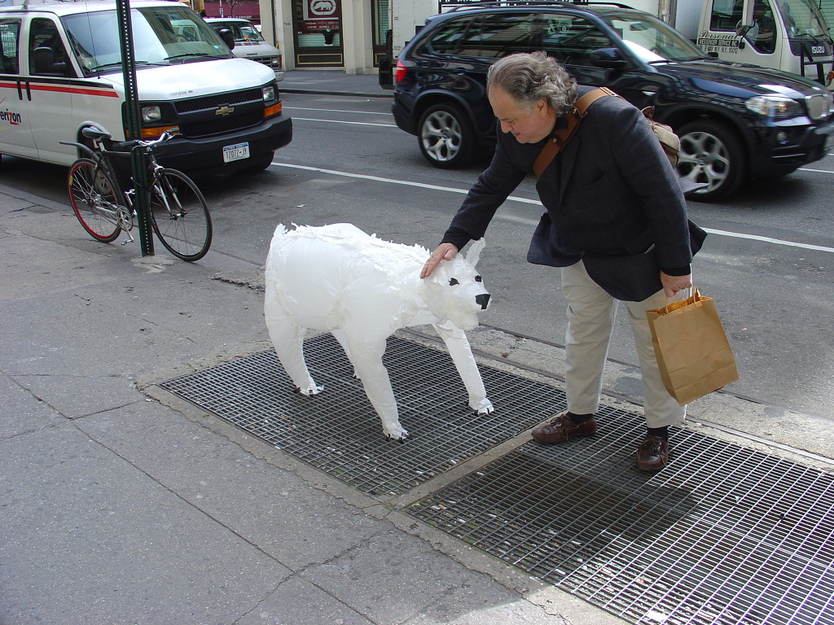
What is street art? (Josh Allen Harris)

Slide 6
What is street art? (Stikman)

Slide 7
What is street art? (Invader)

Slide 8
What is street art? (C. Finley)
http://wallpapereddumpsters.blogspot.com/

Slide 9
What is street art? (Blu & David Ellis)
https://www.youtube.com/watch?v=uad17d5hR5s

Slide 10
What is street art?
An artwork is street art if, and only if, its material use of the street is internal to its meaning.
General Characteristics:
ephemeral
often illegal
artists are pressured to make the art work pop to get attention
extraordinary skill, highly original and imaginative content

Slide 11
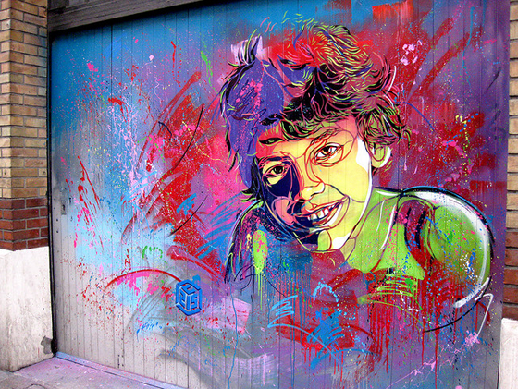
How street art challenges museum culture -
Street art is largely ephemeral art that is usually cheap to make, free to experience, and owned and overseen by no one (or rather, everyone). Museums often contain art that is extremely expensive (to make and own), costly to experience, and overseen by an elite few.

Slide 12
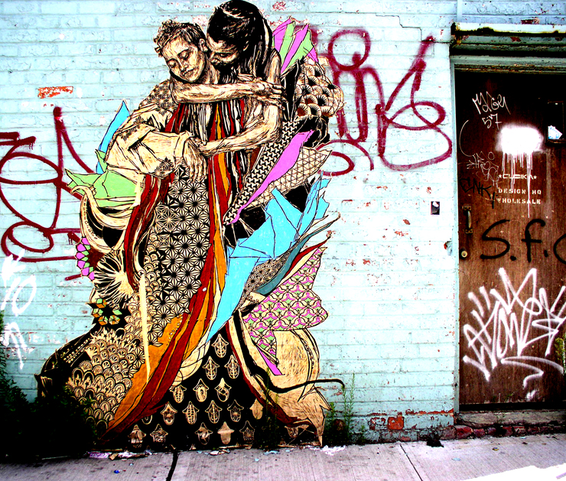
A more pure aesthetic experience?
Walking down the street, on the way to work, a friend’s house, dinner, a bar, a lecture, one haphazardly glances in the right direction and BOOM! – an unsolicited aesthetic injection. One is jolted out of whatever hazy cloud of practical thought one was in; one is forced to reconsider one’s purely practical and rather indifferent relationship to the street, and a curiosity to explore the work develops.

Slide 13
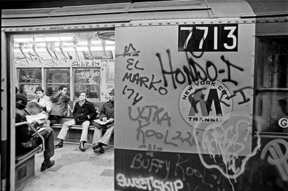
What about graffiti?
Artistic graffiti is public writing in a distinctive style, created with a particular attitude. The material use of the street is irrelevant to its meaning because it can be anywhere and still mean the same thing.
Street art and graffiti are different arts with strong historical connections

Slide 14
Street Art in Austin
http://www.freefuninaustin.com/2014/03/austin-mural-locations.html#.VDSew2ddWSp

Slide 15
Pull out the list of Aesthetics Questions –
Which questions does street art raise for you?
How can we connect this with the Marxist theory from yesterday?
How does the illegality of tagging, graffiti, street art affect our conversation about/acceptance of it?

