Slide 1
Two divisions of philosophy
Normative & descriptive

Slide 2
Descriptive component
How things are & how we know
1. What is the fundamental nature of reality?
2. How do we know about and judge reality?
3. Does God exist?
4. Do we have free will?
This branch includes METAPHYSCIS-what there is and EPISTOMOLOGY –how we know

Slide 3
Normative component (value judgments)
→ How things ought to be
1. Aesthetics – what is beautiful? Why?
2. Moral philosophy- what is morally right or good
3. Political philosophy – how should societies be structured? What makes societal structures legitimate?

Slide 4
Political philosophy- who should get what? And who says so?
→ All members of any society must recognize & consider these questions:
1. What is the best way to structure society for the most good?
2. What is the appropriate division of rights and responsibilities?
3. How should liberty and equality be balanced?

Slide 5
Answer the following questions in your notebook:
1. Should the state provide universal healthcare? Education?
2. Should there be an inheritance tax?
3. Should there be a draft army?
4. Should you be allowed to sell your vote?

Slide 6
Man in society
→ What is the purpose of society?
→ Why did people move from smaller groups to larger ones?
→ What do we get out of these communities?
What is expected of you as a member?
How do we decide who is in charge?

Slide 7
Lasa- a micro society
→ How does the community at LASA work? What have you noticed?
→ What is expected of you in terms of your actions? Reactions? Behaviors toward others? Toward your teacher?
→ What should everyone
a) expect
b) be guaranteed
c) have access to?

Slide 8
What is true about human nature?
Human nature refers to the distinguishing characteristics—including ways of thinking, feeling and acting—which humans tend to have naturally, independently of the influence of culture.
The questions of what these characteristics are, how fixed they are, and what causes them are amongst the oldest and most important questions in western philosophy.
So…. I would like you to start thinking about:
1. What are the personal connections people need to survive and live the “good life?”
2. What does this suggest to you about human nature and your understanding of people (and how we operate)thus far in your young lives?
3. What type of government supports your understanding of human nature?

Slide 9
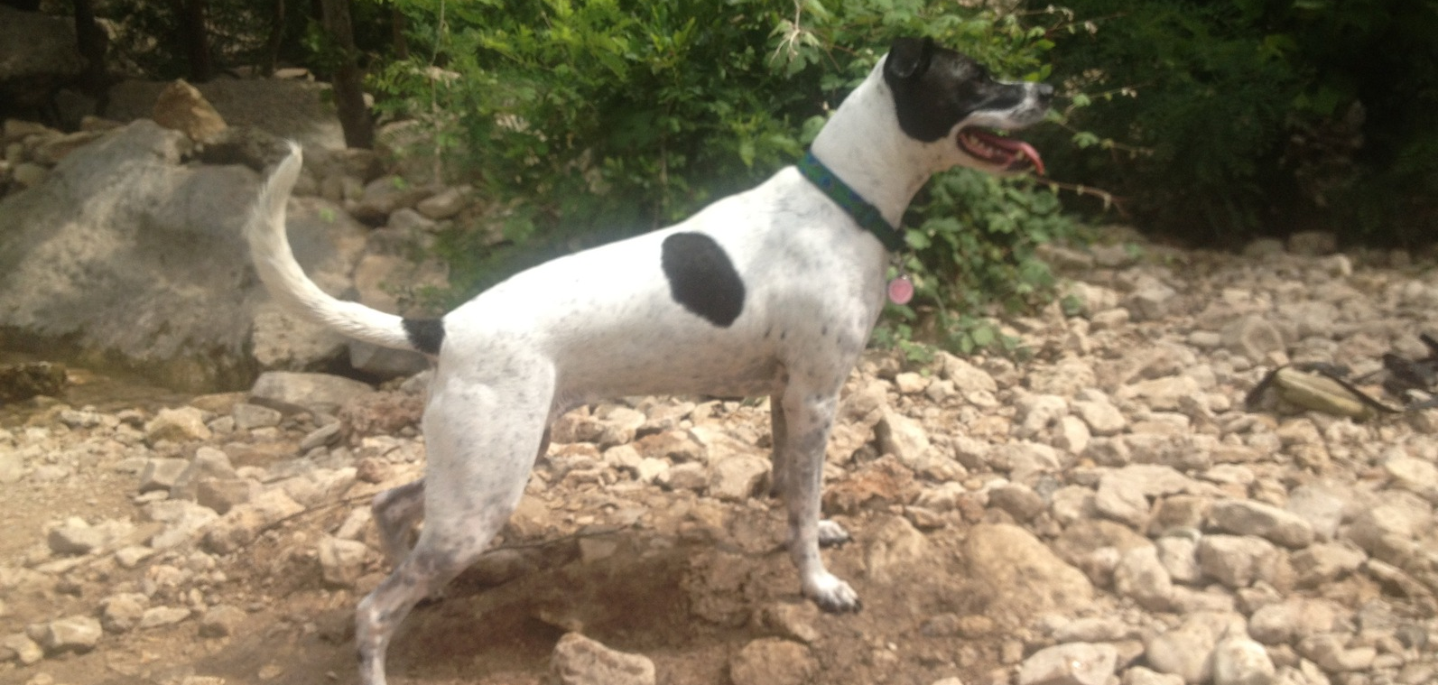
Because everyone needs a dog pic

