Slide 1
John Dewey
Education & Democracy

Slide 2
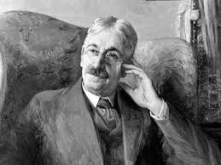
John Dewey
→1859 -1952
→Taught for 3 years as a public school teacher before going on to teach at the collegiate level
→Researched methods of education and tried to determine the best way humans learn/ work collectively in an educated democracy
Well known works: How We Think Democracy and Education Experience and Education A Common Faith

Slide 3
Dewey was confronted with a system of education that looked like…
Absolute control by the teacher
Learning from text/ teacher lecture
Students expected to regurgitate information learned from texts and teachers
Teacher was absolute master (disperser) of knowledge (telling you what you must know), rather than a guide helping you discover what you are interested in learning

Slide 4
What changes did he want to see? - Education centered around student interest - Education that included real/active experiences -Curriculum is written/directed by student interest (curiosity drives student learning)

Slide 5
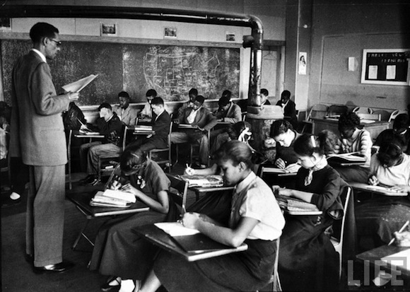
Applicable Results through instruction = Best education possible
Interactions + Reflections and Experience + Interest in Democracy = Dewey’s Ideal learning conditions
He believed children learn best through real life tasks and challenges + interactions with other people

Slide 6
Applicable Results through instruction = Best education possible
Interest should be the motive for all work
Rejected the idea of simply learning from texts/ lectures in a structured/ restrictive classroom setting

Slide 7
Education for citizens in a democratic society
-Known for his advocacy of democracy, Dewey considered two fundamental elements—schools and civil society as being major topics needing attention and reconstruction
-Dewey asserted that complete democracy was to be obtained not through voting but also by ensuring there exists a fully formed public opinion, accomplished by communication among citizens, experts, and politicians (with the latter being accountable for the policies they adopt)
-In order for this to take place, citizens must be properly educated (must take ownership of their education) and participate in social activities that encourage growth and sustainability of the educational system

Slide 8
"Education is a social process; education is growth; education is not a preparation for life but is life itself." - Dewey

